Slide 1

CIS 9655 - Data Visualization
Group Project
Group Number - 13
Analyzing Global Startup Funding

Slide 2



Team Members
Ashlesha Ingale
Bhanuteja Perumandla
Janvi Bagani
Ms in Business Analytics
Ms in Business Analytics
Ms in Business Analytics

Slide 3
Introduction
Our project aims to uncover how funding fuels the growth of startups.
We dive into real investment data to understand which sectors attract the most capital, when that funding happens, and how it shapes a startup’s journey.
By visualizing these trends, we aim to tell a clear story behind what makes startups succeed.

Slide 4

Background Project
Current scenario:
Startups are reshaping industries like technology, healthcare, and sustainability through innovation.
Their growth often depends on receiving the right funding at the right time.
In this project, we use Crunchbase data to examine where investments are going, which sectors attract them, and how early funding influences long-term success.

Slide 5

Hypothesis
Hypothesis:
Startups in technology-driven sectors like software, fintech, and biotech receive higher funding amounts across all stages compared to traditional industries. Additionally, startups that raise larger funding amounts in their initial stages (Seed, Series A) are more likely to secure follow-on funding and eventually reach later stages like Series C, D, or even IPO.
Why this Hypothesis:
This is based on an observation we see in the real-world tech startups often promise scalability and disruptive potential, which makes them attractive to investors. But we want to validate this using real data is it just a perception, or does the data actually show this trend? And do those early millions really make or break a company’s future?

Slide 6

Our Data and How We Used It
Primary Dataset - Crunchbase
We used data on startups and investors — including markets, funding rounds, and outcomes.
It gave us a solid view of how money moves in the startup world.
Secondary Dataset - Investor
To understand the influence of individual investors, we merged this primary dataset.
This enables us to uncover patterns such as investor preferences by market and funding behavior over time.
Why This Data?
Crunchbase is a go-to source for startup funding insights.
It helped us connect funding trends with real investor behavior.

Slide 7
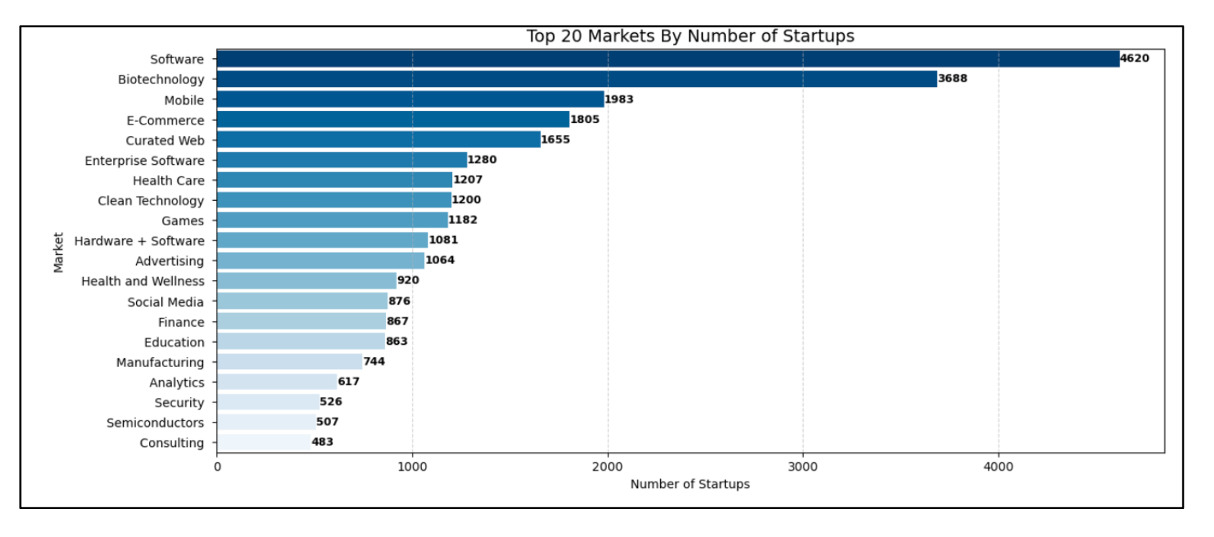
Market Volume,Where Startups Are Emerging
Let’s start by looking at where startups are being built. Software, Biotech, and Mobile lead the pack, together making up almost half of the startup space.

Slide 8
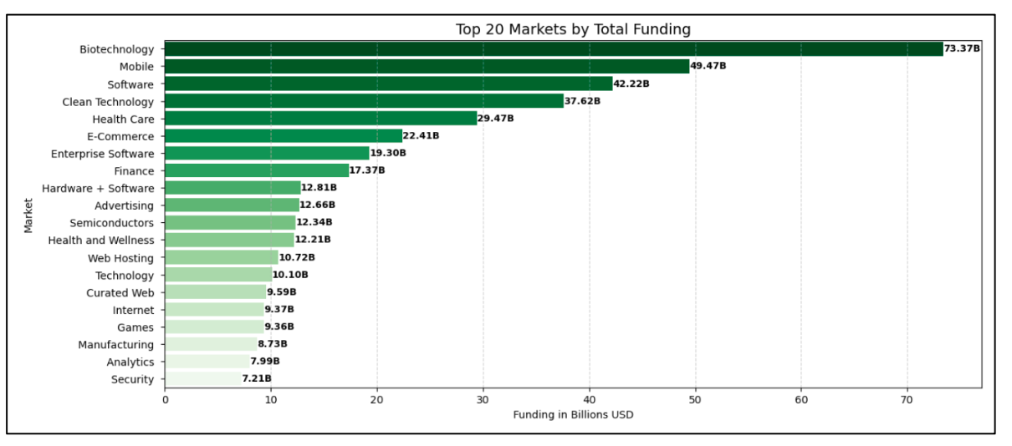
Market Funding, Where the Money Goes
Now we shift to where the money flows. Biotech clearly dominates in total funding, showing investor confidence in health and life science innovation.

Slide 9
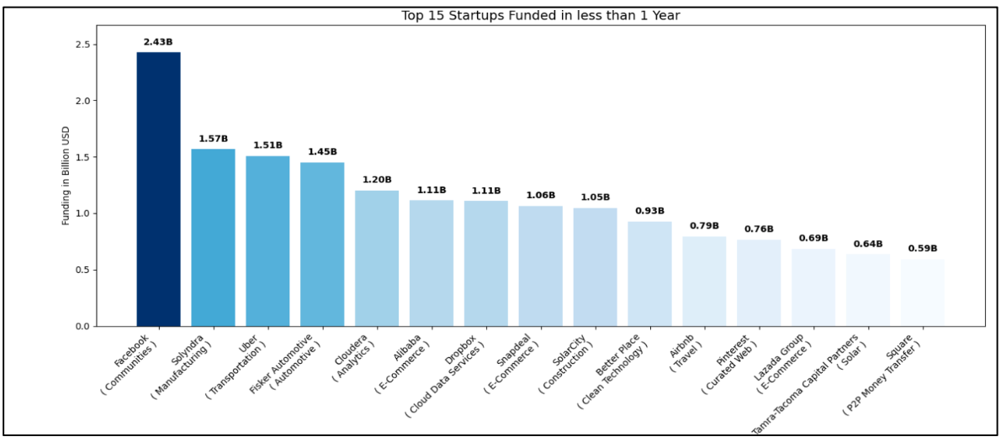
Startups Funded in Under a Year
Startups like Facebook and Uber raised massive rounds within a year. Fast funding reflects strong investor belief and market readiness.

Slide 10
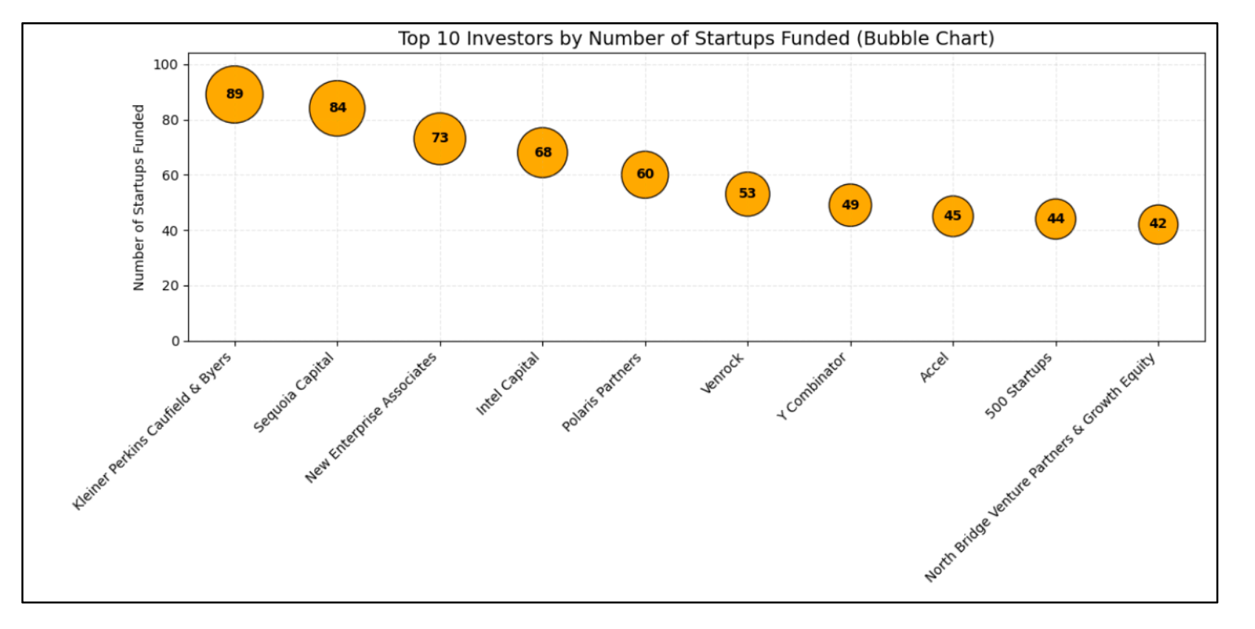
Who's Investing in Startups?
These are the top players backing startups at scale. Sequoia, Intel Capital, and NEA appear again and again, driving growth across key markets.

Slide 11
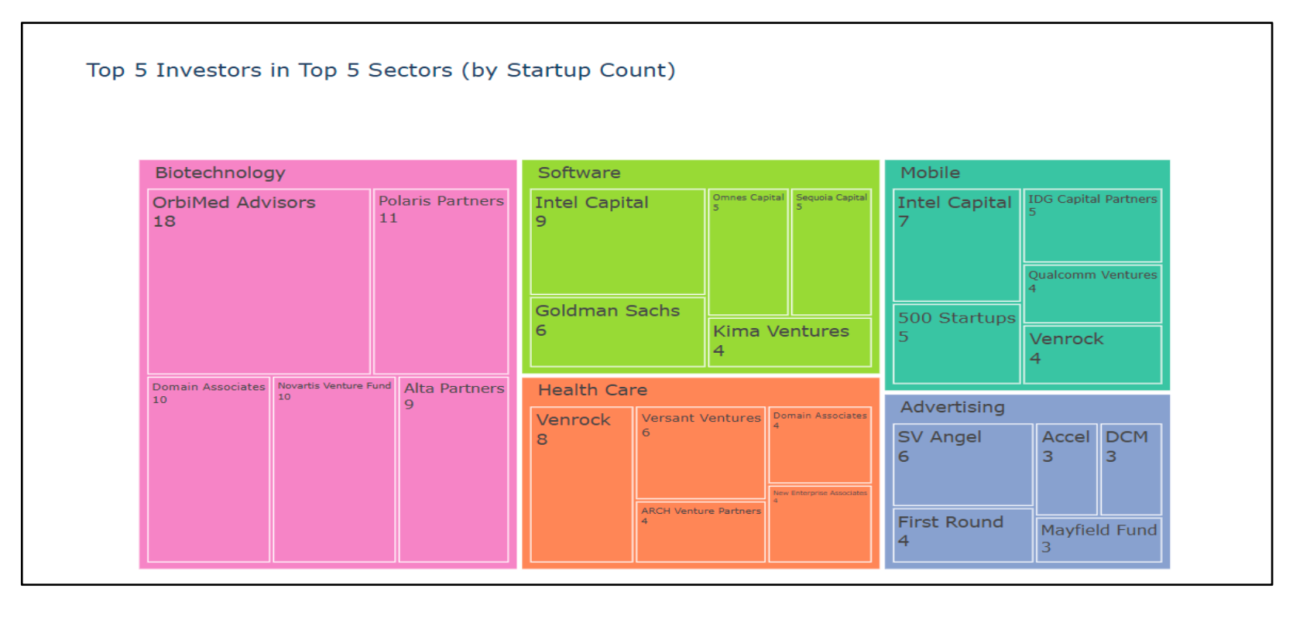
Investor Focus by Sector
Major investors specialize by sector, OrbiMed in Biotech, Intel Capital in Software. This shows clear alignment between investor expertise and market focus.

Slide 12
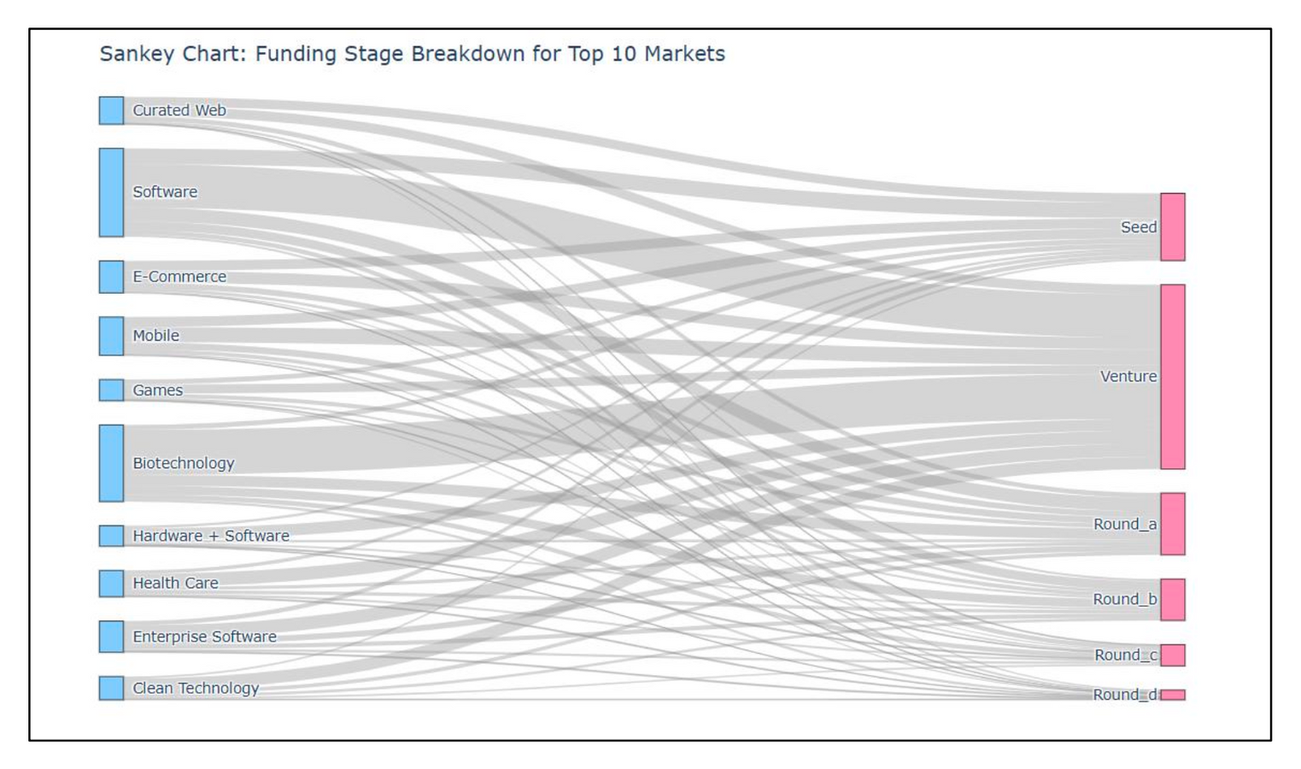
How Funding Flows Across Sectors
This Sankey chart maps funding flow from sectors to rounds. Tech sectors move deep into later rounds, traditional ones rarely get that far.

Slide 13
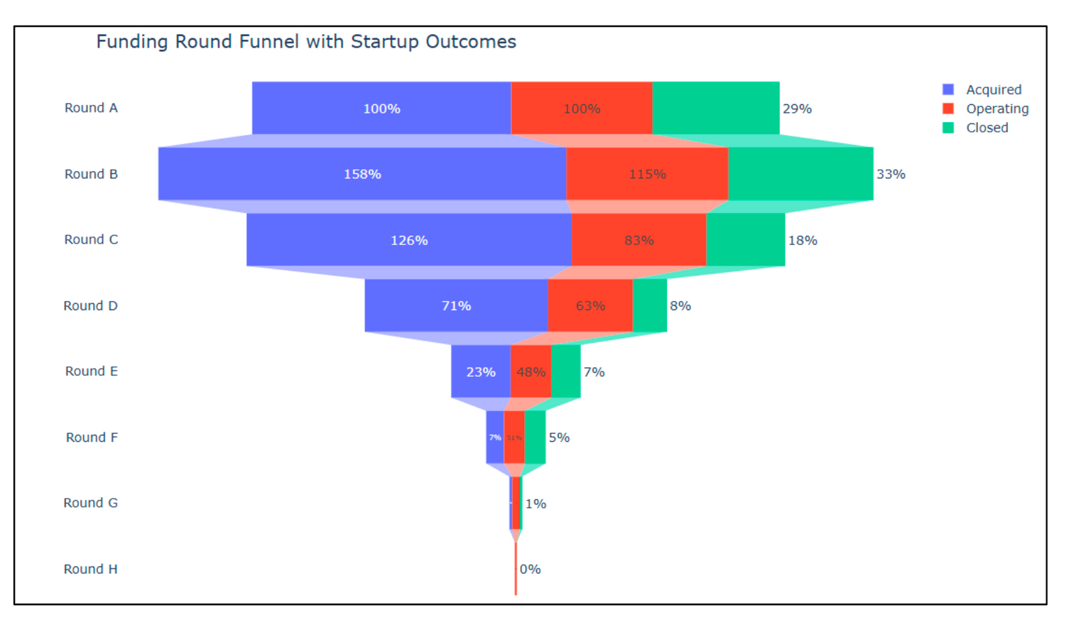
Startup Progression Funnel
The funnel plot shows how startups progress through funding rounds and there
eventual status. Round B funding has the most startups under it, followed by Round A funding. Many startups drop off after Round C, often due to funding gaps or market fit.

Slide 14
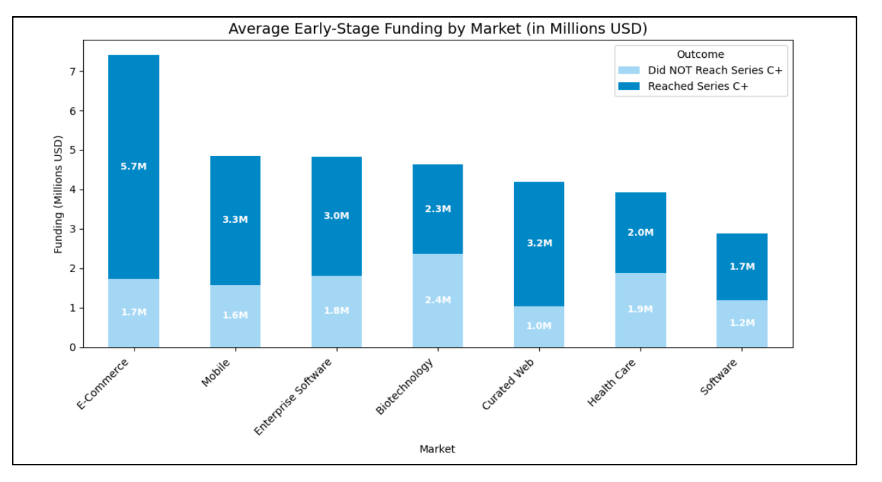
Early Funding vs. Long-Term Progression
Startups with strong early funding were more likely to reach Series C+. This shows early stage investment often drives long-term growth.

Slide 15
Conclusion
Through our analysis and visualizations, we found that capital consistently flows toward innovation-driven sectors like software, biotech, and fintech. These sectors not only have the highest number of startups but also receive the most funding. Startups that raised more in their early stages were much more likely to progress to later rounds like Series C, D, or even IPO. This supports our hypothesis: early-stage investment plays a key role in long-term startup success. The data shows that when innovation is backed early, growth is more likely to follow.

Slide 16
Thank you

